Slide 1
Machine Learning Part V Anomaly Detection/ Recommender System

Slide 2
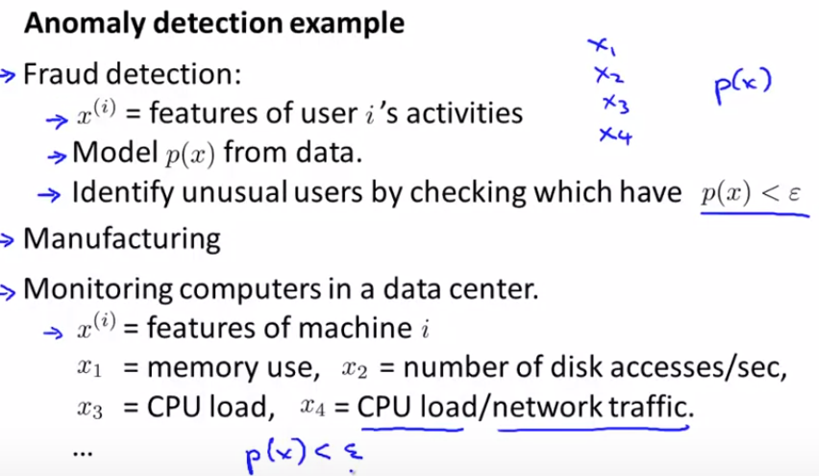


Slide 3
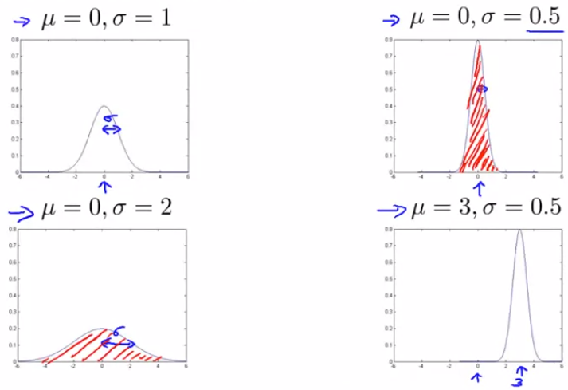
Gaussian (Normal) Distribution
Probability distribution (add up to 1)

Slide 4
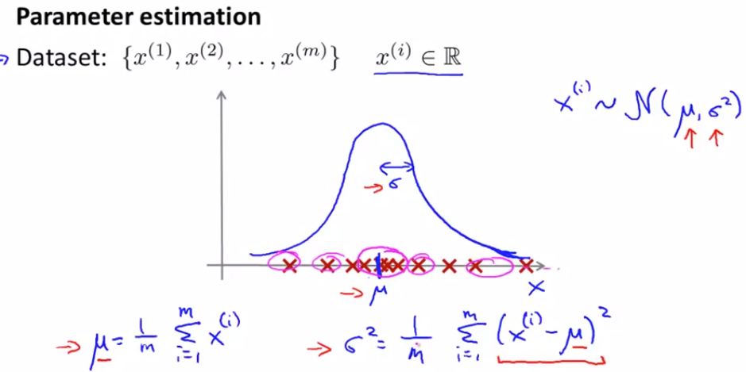

Slide 5
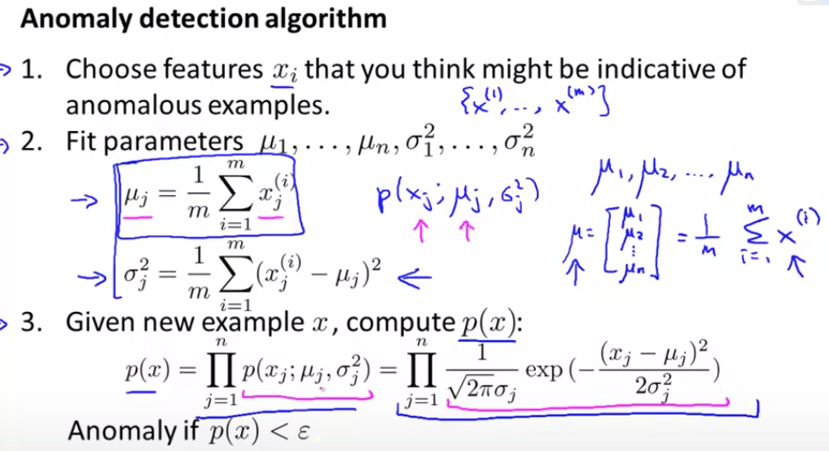

Slide 6
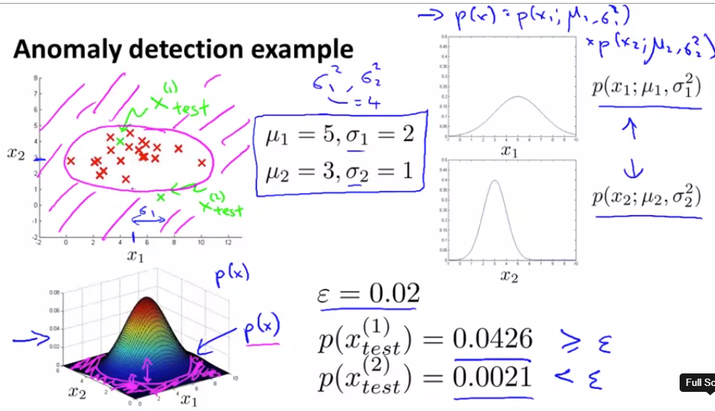
Visualization

Slide 7
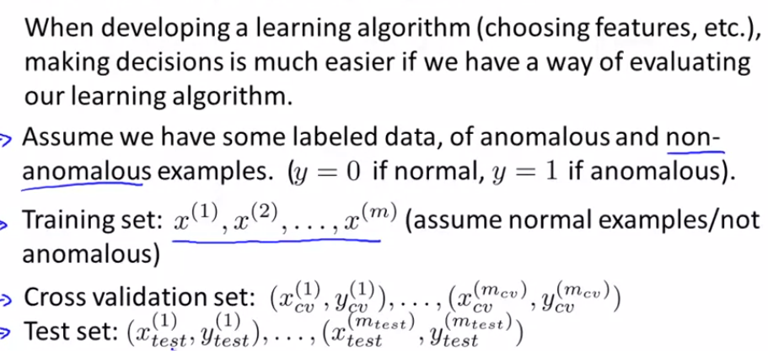
Evaluation (supervised learning)

Slide 8
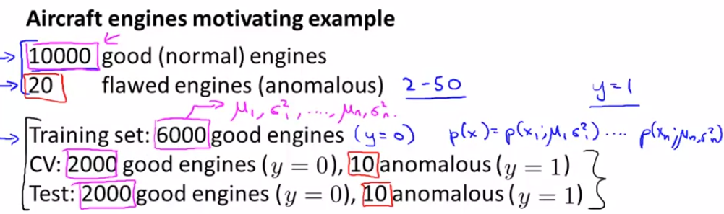

Slide 9
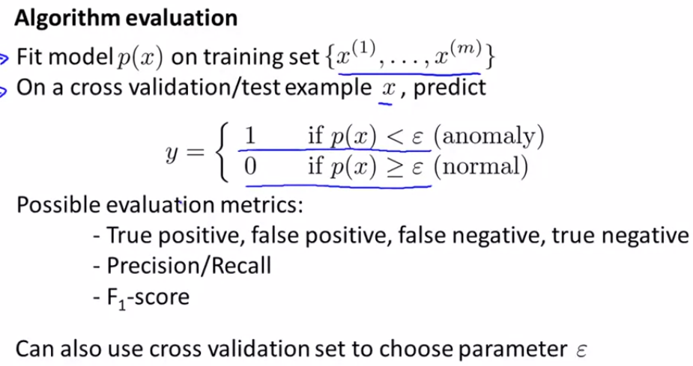
Also, use validation set to decide what features to include (square co?)

Slide 10
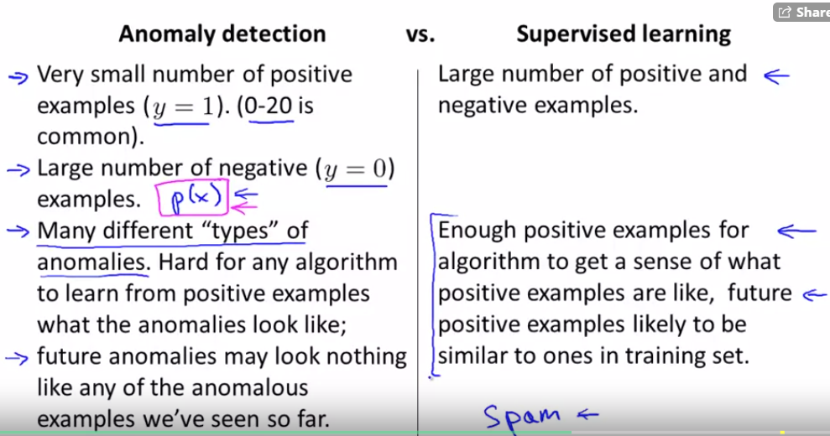

Slide 11
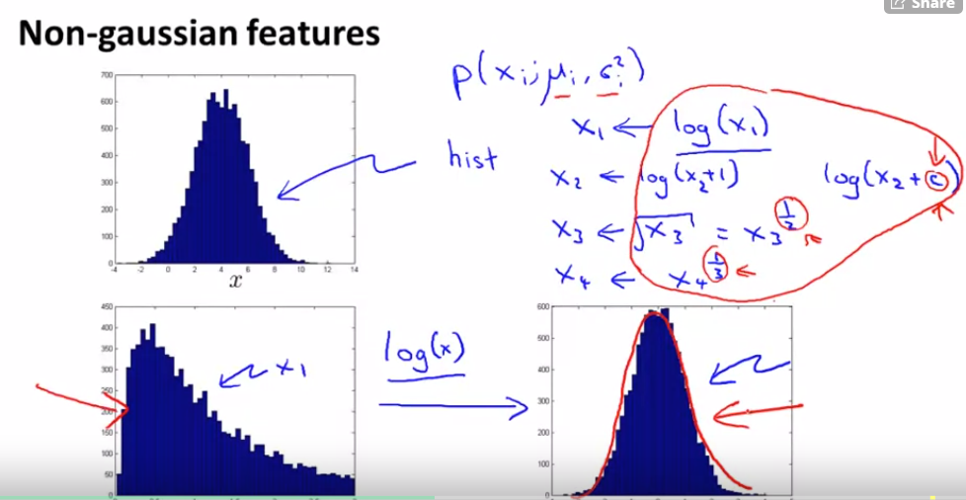

Slide 12
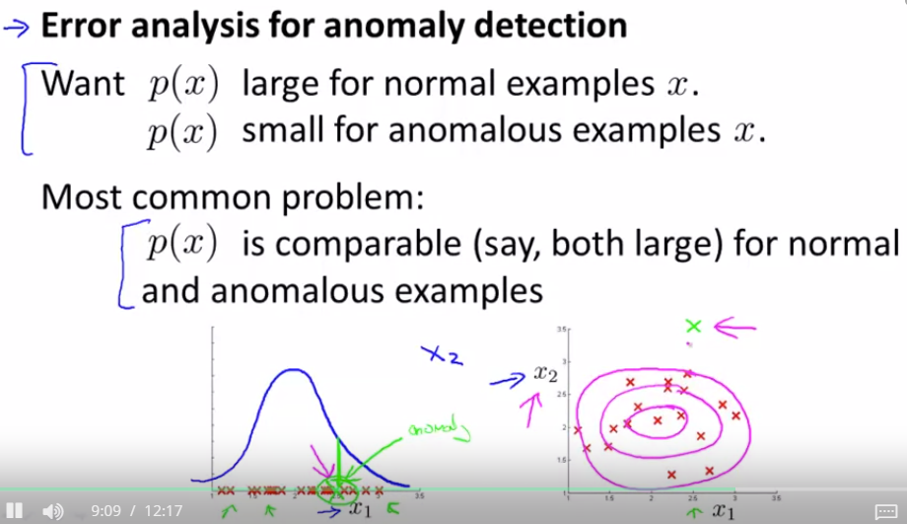
Adding features that can distinguish normal and anomalous samples

Slide 13
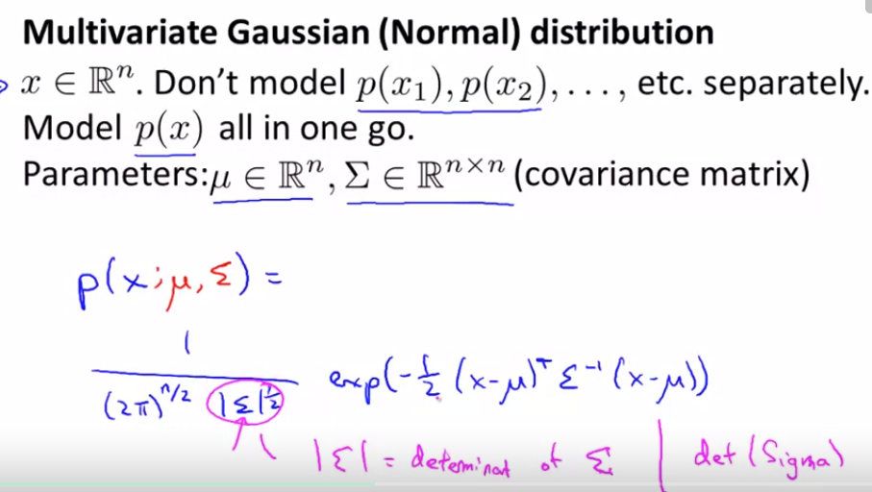

Slide 14
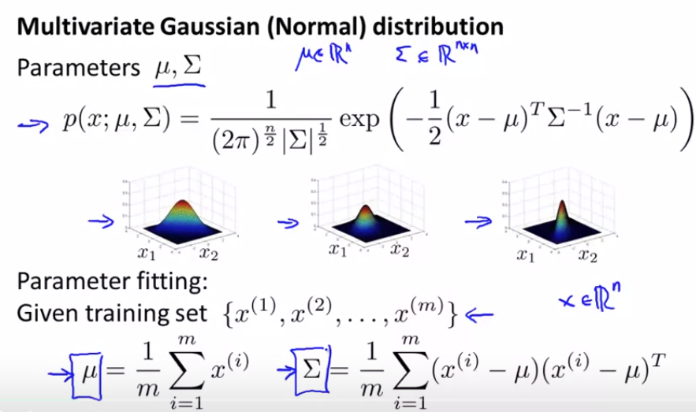


Slide 15
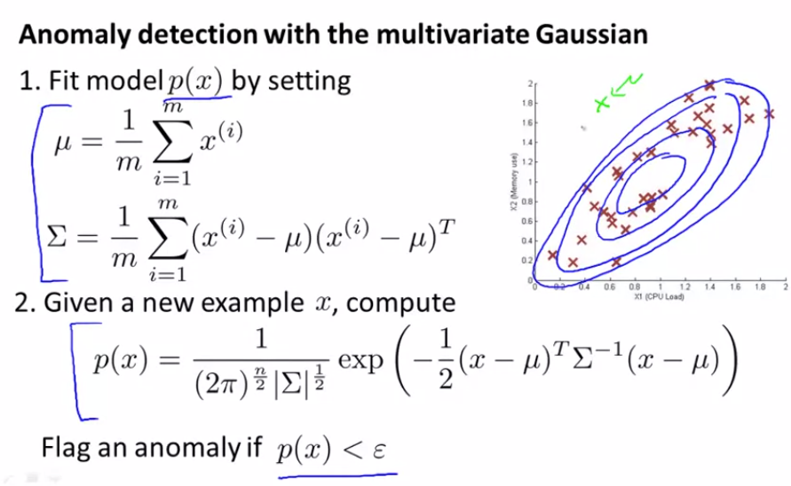

Slide 16
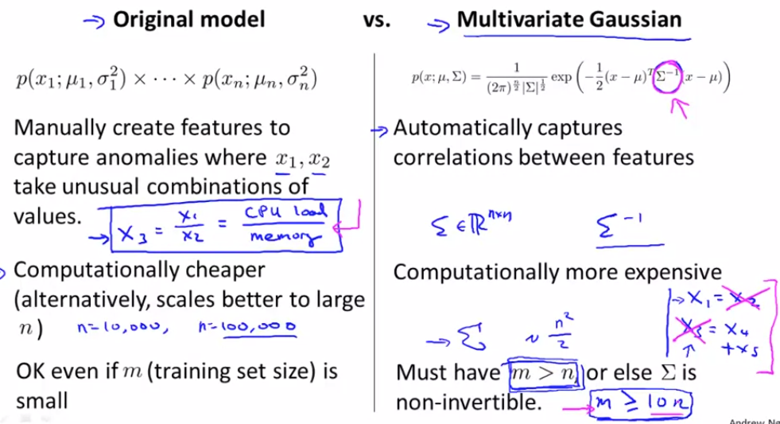




Slide 17
Recommender Systems

Slide 18
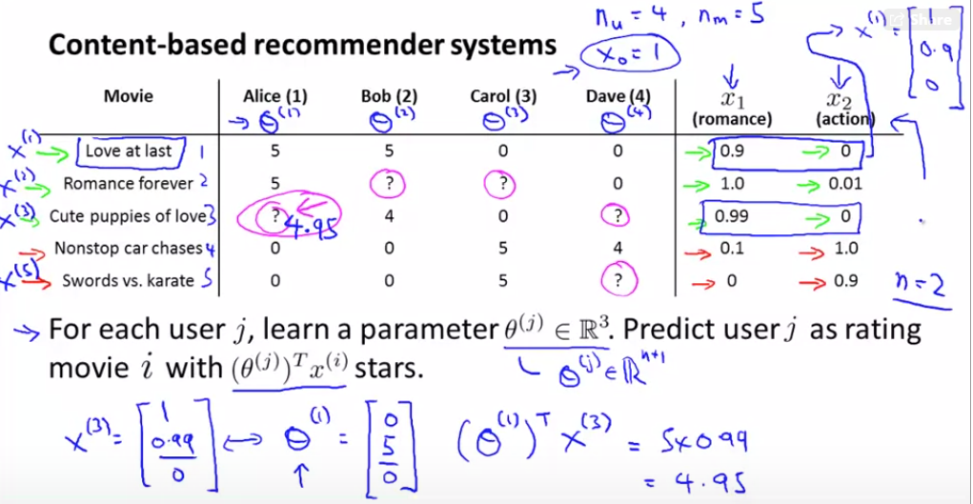

Slide 19
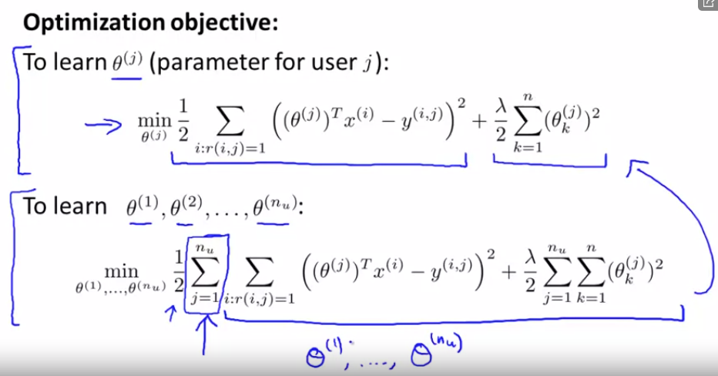
Content Based Recommendations
content means we have the features to describe the product
It is essentially a linear regression problem, only that we train a set of parameters for each user.

Slide 20
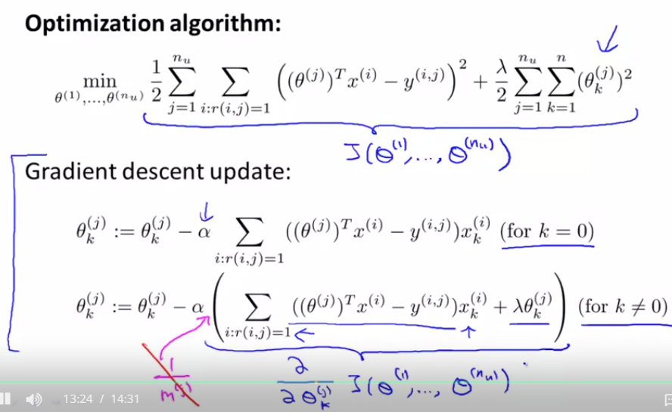

Slide 21
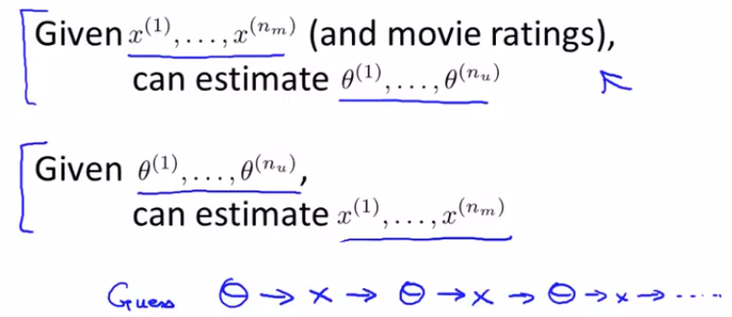
Collaborative Filtering
Each movie is a vector of genre features
Each audience is also a vector of preference features

Slide 22
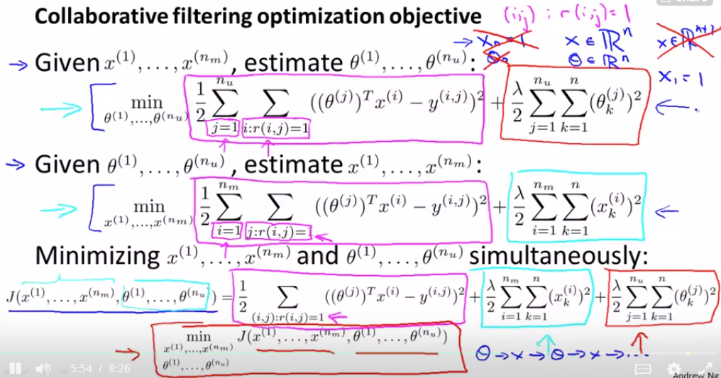
Learn x and θ in simultaneously!

Slide 23
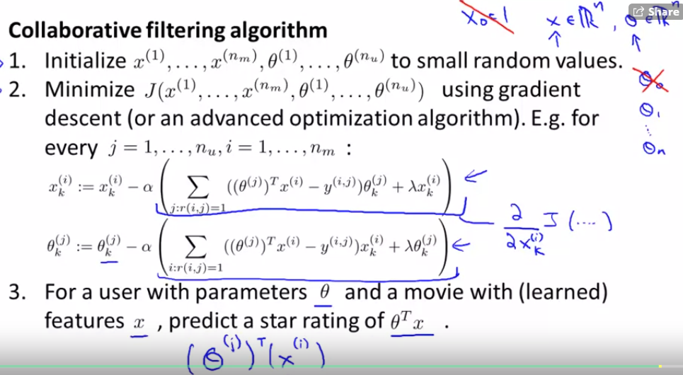


Slide 24
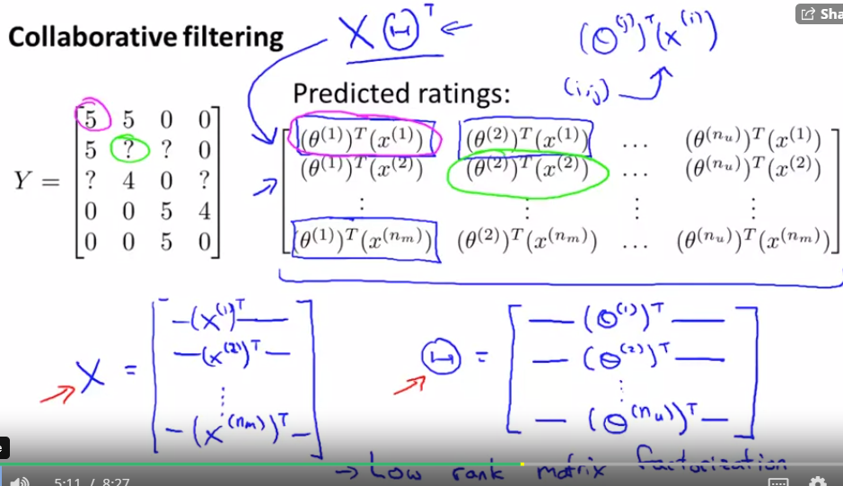
Vectorization

Slide 25
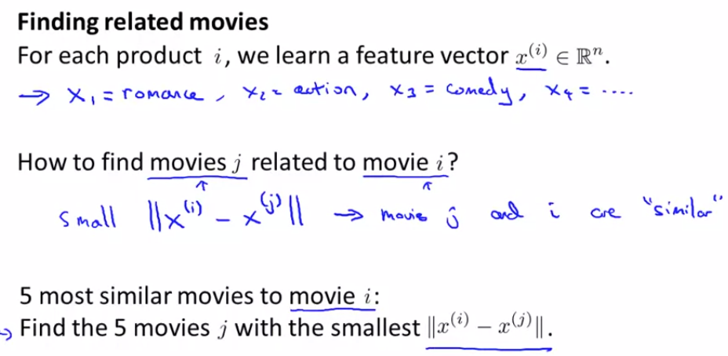

Slide 26


Movie rating to network setting?
Bipartite network (users, movies)
Objective: link weight prediction (predict user rating for unseen movies).
common 3 hop neighbors between a user and a movie
m1
u1
m2
u2
m3
u3
m4

Slide 27
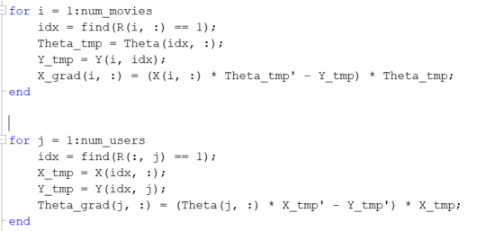
Ex8-2.2.2 of Collaborative Filtering

